Slide 1
Final Report SportStats
Alex Pey
21/06/2021

Slide 2
Contents
Review of Questions to Answer / Hypotheses / Approach
Technical Challenges
Entity Relationship Diagram (ERD)
Initial Findings
Deeper Analysis
Hypotheses Results
Recommendation

Slide 3
Review of Questions to Answer / Hypotheses / Approach
Questions to Answer
Q1: Is there any correlation between the performance of a country in winter Olympics and that in summer Olympics?
Q2: Does country performance by year change more in Winter Olympics or Summer Olympics?
Q3: Has the male : female ratio evolved through time?
Initial Hypotheses
H1: Yes
H2: Winter Olympics
H3: Decreased
Data Analysis Approach
A1: Calculate the Pearson correlation coefficient
A2: Calculate the standard deviation in country performance through years. A Comparison between average std of Winter and that of Summer Olympics will help
A3: Draw a simple histogram

Slide 4
Technical Challenges
Encountered challenges with getting the starting year of the Summer Olympics different from that of the Winter Olympics
Limitation of Pandasql (Sqlite) made some SQL difficult to execute but manageable

Slide 5
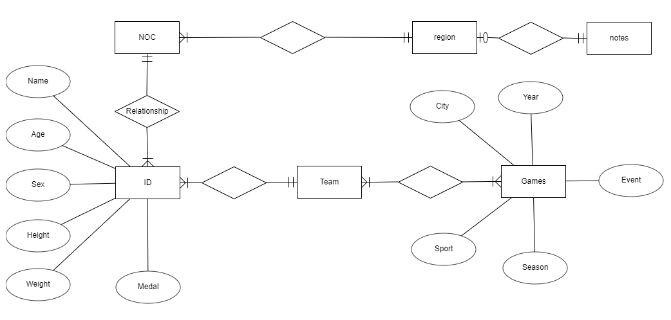
Entity Relationship Diagram (ERD)

Slide 6
Initial Findings
The ratio between the Summer Olympics and the Winter Olympics is different where men are more dominant. The assumption is that the ratio of women to men has increased over time. Further action to look into this
There are significant differences between male and female participants not only in terms of expected height and weight, but also in terms of age. The first two differences can be attributed to biology. Although the latter may require more than just: it is worth considering social factors at the same time.
Another interesting fact is that the age gap in the Winter Olympics is closer (Range between 2.8 to 1.5 years old)
Another analysis of the number and ratio of medals is needed, checking the ratio of total medal winners and the changes in the ratio of different medals

Slide 7
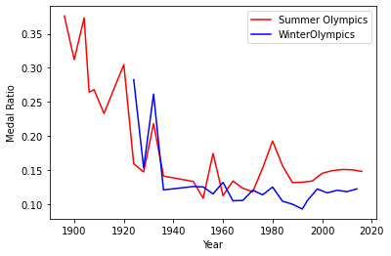
Initial Findings
In the last century, the medal ratio fluctuated greatly in the two competitions, but eventually stabilized. This can be interpreted as establishing norms on these issues.

Slide 8
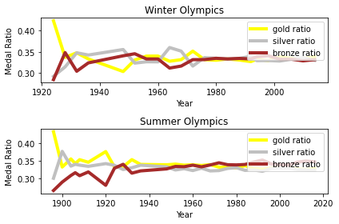
Initial Findings
The relative percentages of gold, silver and bronze medals have also stabilized, which may be due to the reasons mentioned above.

Slide 9
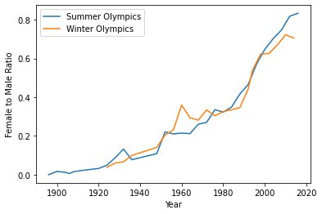
Initial Findings
This assumption seems to be correct. Over time, the ratio of women to men has indeed increased. However, there is an interesting detail: during the Second World War, the proportion of the Summer Olympics dropped sharply, but then it resumed its growth momentum. Without further analysis, I cannot explain for now

Slide 10
Deeper Analysis
The length of the array of the number of medal count in the winter Olympics and summer Olympics are different because Winter Olympics started in 1924, but Summer Olympics started in 1896. Therefore I have to create a new shortened table of the summer Olympics started in 1924 to match the length of the winter Olympics.
The Pearson correlation coefficient between the total number of medals in the winter and summer Olympics from 1924 to 2016, is 0.94, which is highly positive. Therefore, the performance of a country in winter Olympics is highly correlated to that in summer Olympics
I will then calculate the standard deviation in country performance through years. A Comparison between average std of Winter and that of Summer Olympics will help.
std_medal_count_summer_olympics = 475
std_medal_count_winter_olympics = 153
From 1924 to 2016, as the standard deviation in the summer Olympics is about 3 times than in the winter Olympics, country performance by year change more in Summer Olympics.

Slide 11
Hypotheses Results
Initial Hypotheses
H1: Yes
H2: Winter Olympics
H3: Decreased
Hypotheses Result
Yes, the performance of a country in winter Olympics is highly correlated to that in summer Olympics
Yes, the country performance by year change more in Winter Olympics than that in Summer Olympics.
Yes, The male : female ratio has decreased from 1896 to 2016

Slide 12
Recommendation
The Olympic Organizing Committee should devote more resource in the weather prediction to better organize the Olympics as the weather affects the performance of athletes
The Olympic Organizing Committee should advocate equality between male and female and drive more to encourage female Athletes to join the Olympics

